Slide 1
Memory Devices (Part-2)
Md. Azmain Yakin Srizon
Lecturer, Dept. of CSE, RUET

Slide 2
Modules
Module-1: Read-Only Memories
Module-2: ROM Architecture
Module-3: ROM Timing
Module-4: Types of ROMs
Module-5: Flash Memory
Module-6: ROM Applications

Slide 3
Module-1
Read-Only Memories

Slide 4
Read-Only Memories
The read-only memory is a type of semiconductor memory designed to hold data that either are permanent or will not change frequently.
During normal operation, no new data can be written into a ROM, but data can be read from ROM.
For some ROMs, the data that are stored must be built-in during the manufacturing process; for other ROMs, the data can be entered electrically.
The process of entering data is called programming or burning-in the ROM.
Some ROMs cannot have their data changed once they have been programmed; others can be erased and reprogrammed as often as desired.

Slide 5
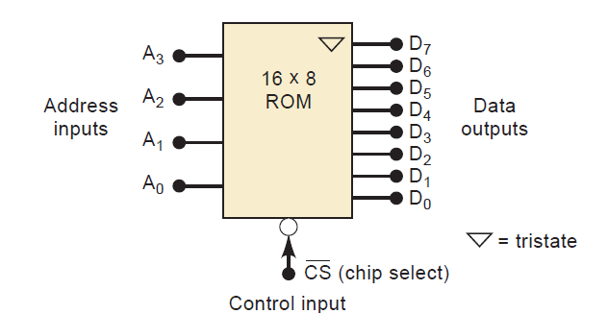
ROM Block Diagram
Fig. 1.1: Typical ROM block symbol.

Slide 6
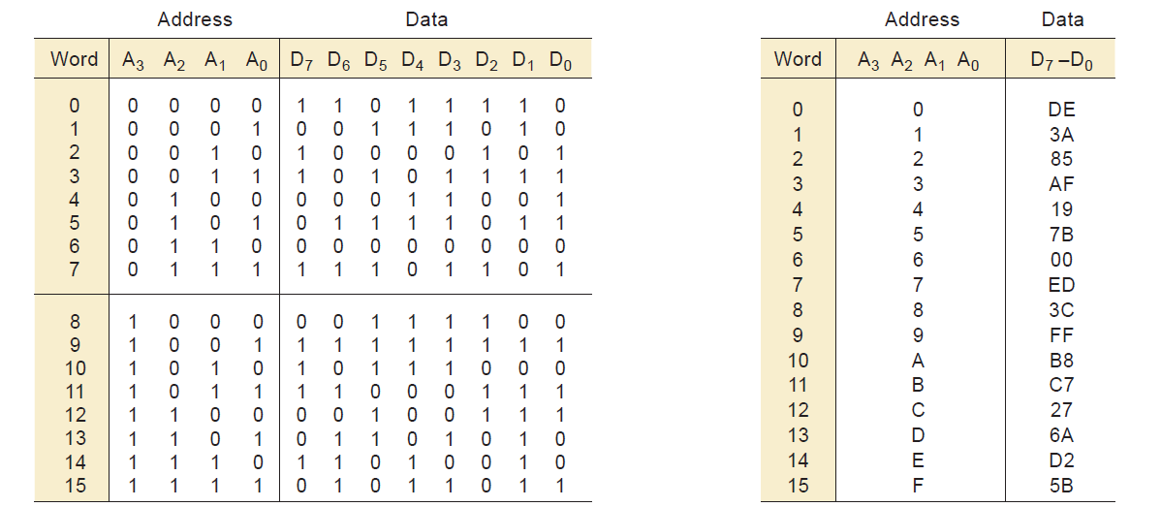
The Read Operation
Fig. 1.2: Table showing binary data at each address location (left), the same table in hex (right).

Slide 7
The Read Operation
In order to read a data word from ROM, we need to do two things:
(1) apply the appropriate address inputs and then
(2) activate the control inputs.

Slide 8
Review Questions
True or false: All ROMs are nonvolatile.
Describe the procedure for reading from ROM.
What is programming or burning-in a ROM?

Slide 9
Module-2
ROM Architecture

Slide 10
ROM Architecture
The internal architecture (structure) of a ROM IC is very complex, and we need not be familiar with all of its detail.
It is instructive, however, to look at a simplified diagram of the internal architecture.
There are four basic parts: register array, row decoder, column decoder, and output buffers.

Slide 11
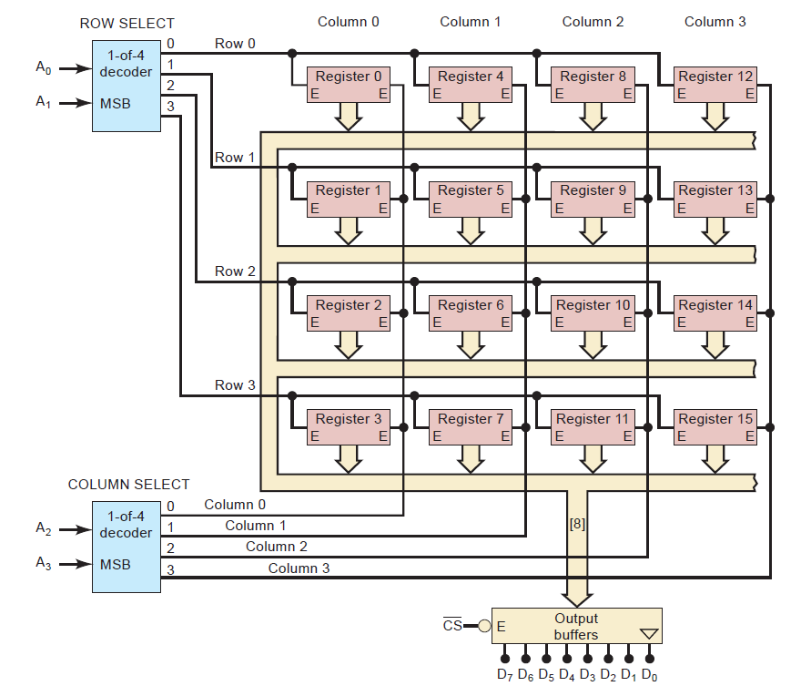
ROM Architecture
Fig. 2.1: Architecture of a $16×8$ ROM. Each register stores one eight-bit word.

Slide 12
Register Array
The register array stores the data that have been programmed into the ROM.
Each register contains several memory cells equal to the word size.
In this case, each register stores an eight-bit word.
The registers are arranged in a square matrix array that is common to many semiconductor memory chips.
We can specify the position of each register as being in a specific row and a specific column.
For example, register 0 is in row 0, column 0, and register 9 is in row 1, column 2.

Slide 13

Address Decoders
The applied address code $A_{3}A_{2}A_{1}A_{0}$ determines which register in the array will be enabled to place its eight-bit data word onto the bus.
Address bits $A_{1}A_{0}$ are fed to a 1-of-4 decoder that activates one row-select line, and address bits $A_{3}A_{2}$ are fed to a second 1-of-4 decoder that activates one column-select line.

Slide 14

Example 2.1
Question: Which register will be enabled by input address 1101?
Solution:
$A_{3}A_{2}=11$ will cause the column decoder to activate the column 3 select line,
and $A_{1}A_{0}=01$ will cause the row decoder to activate the row 1 select line.

Slide 15
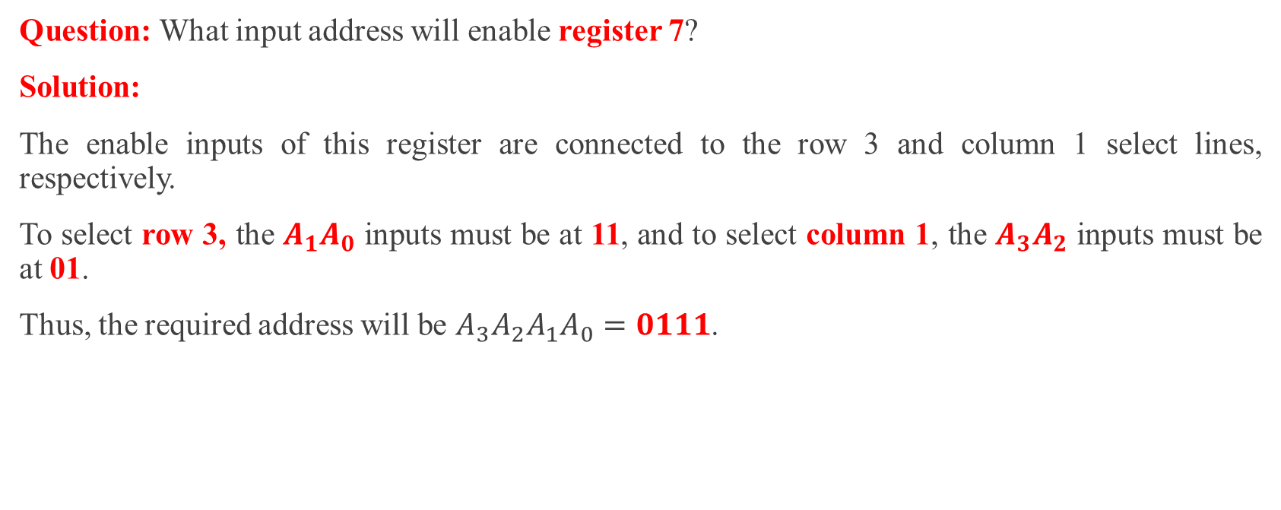
Example 2.2
Question: What input address will enable register 7?
Solution:
The enable inputs of this register are connected to the row 3 and column 1 select lines, respectively.
To select row 3, the $A_{1}A_{0}$ inputs must be at 11, and to select column 1, the $A_{3}A_{2}$ inputs must be at 01.
Thus, the required address will be $A_{3}A_{2}A_{1}A_{0}=0111$.

Slide 16

Output Buffers
The register that is enabled by the address inputs will place its data on the data bus.
These data feed into the output buffers, which will pass the data to the external data outputs, provided that $\overline{CS}$ is LOW.

Slide 17
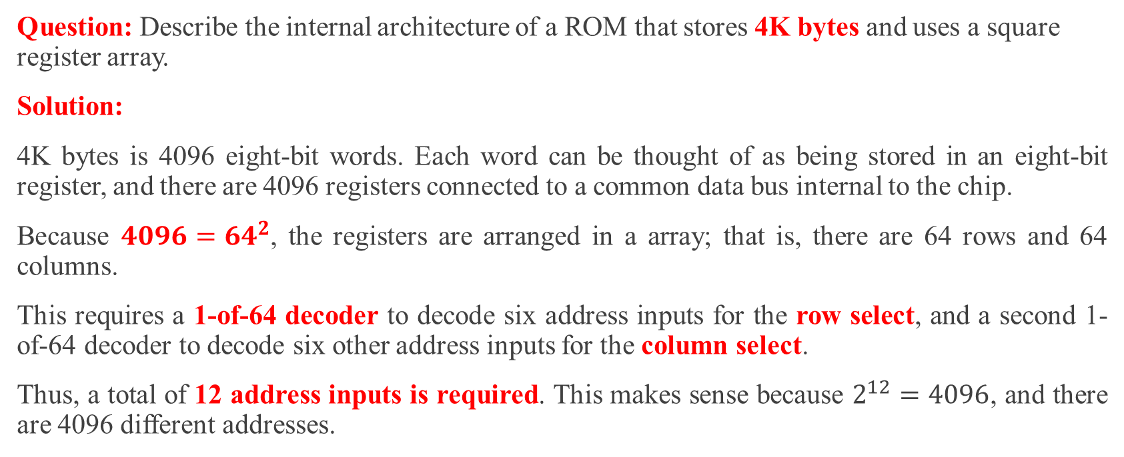
Example 2.3
Question: Describe the internal architecture of a ROM that stores 4K bytes and uses a square register array.
Solution:
4K bytes is 4096 eight-bit words. Each word can be thought of as being stored in an eight-bit register, and there are 4096 registers connected to a common data bus internal to the chip.
Because $4096={64}^{2}$, the registers are arranged in a array; that is, there are 64 rows and 64 columns.
This requires a 1-of-64 decoder to decode six address inputs for the row select, and a second 1-of-64 decoder to decode six other address inputs for the column select.
Thus, a total of 12 address inputs is required. This makes sense because $2^{12}=4096$, and there are 4096 different addresses.

Slide 18
Review Questions
What input address code is required if we want to read the data from register 9 in Figure 2.1?
Describe the function of the row-select decoder, the column-select decoder, and the output buffers in the ROM architecture.

Slide 19
Module-3
ROM Timing

Slide 20
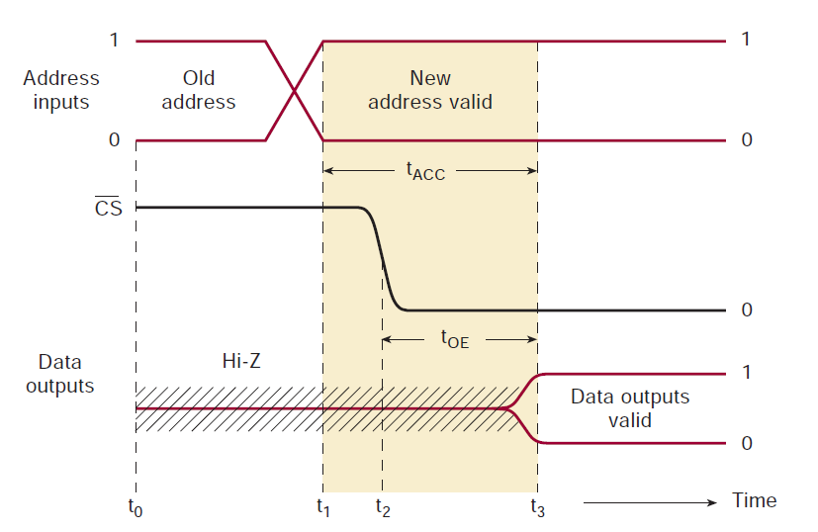
ROM Timing
Fig 3.1: Typical timing for a ROM read operation.

Slide 21
Module-4
Types of ROMs

Slide 22
Types of ROMs
Now that we have a general understanding of the internal architecture and external operation of ROM devices, we will look at the various types of ROMs to see how they differ in the way they are programmed, erased, and reprogrammed.
Mask-Programmed ROM (MROM)
Programmable ROMs (PROMs)
Erasable Programmable ROM (EPROM)
Electrically Erasable PROM (EEPROM)
CD-ROM

Slide 23
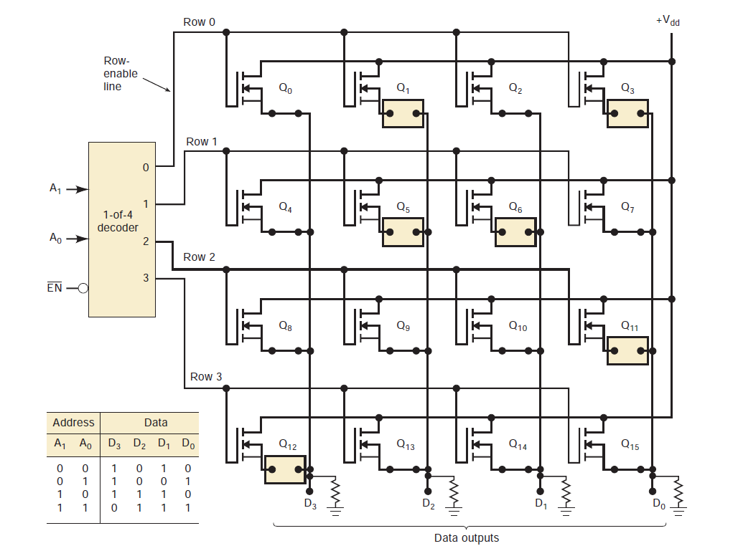
Mask-Programmed ROM
Fig 4.1: Structure of a MOS MROM shows one MOSFET used for each memory cell. An open source connection stores a “0”; a closed source connection stores a “1”.

Slide 24
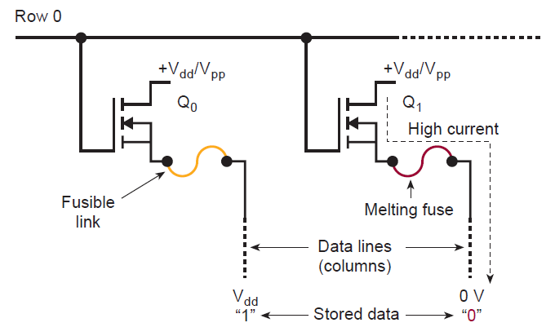
Programmable ROMs (PROMs)
Fig 4.2: PROMs use fusible links that can be selectively blown open by the user to program a logic 0 into a cell.

Slide 25
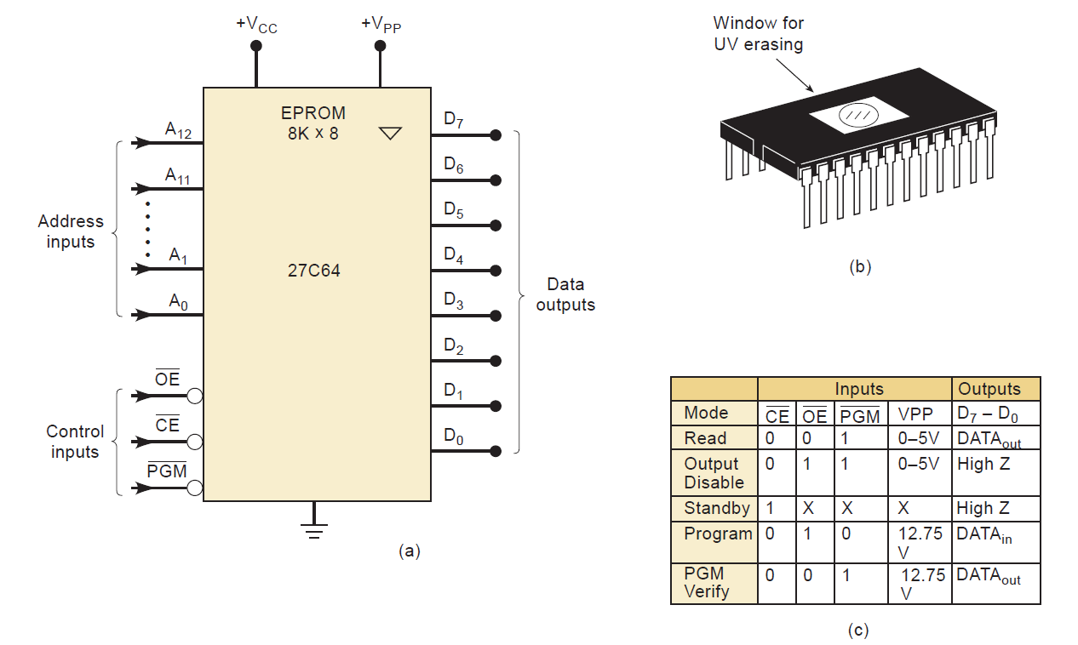
Erasable Programmable ROM (EPROM)
Fig 4.3: (a) Logic symbol for 27C64 EPROM; (b) typical EPROM package showing ultraviolet window; (c) 27C64 operating modes.

Slide 26
Electrically Erasable PROM (EEPROM)
The disadvantages of the EPROM were overcome by the development of the electrically erasable PROM (EEPROM) as an improvement over the EPROM.
The EEPROM retains the same floating-gate structure as the EPROM, but with the addition of a very thin oxide region above the drain of the MOSFET memory cell.
This modification produces the EEPROM’s major characteristic— its electrical erasability.

Slide 27
CD-ROM
A very prominent type of read-only storage used today in computer systems is the compact disk (CD).
The disks are manufactured with a highly reflective surface.
To store data on the disks, a very intense laser beam is focused on a very small point on the disk.
This beam burns a light-diffracting pit at that point on the disk surface.
Digital data (1s and 0s) are stored on the disk one bit at a time by burning or not burning a pit into the reflective coating.
The digital information is arranged on the disk as a continuous spiral of data points.
The precision of the laser beam allows very large quantities of data (over 550 Mbytes) to be stored on a small, 120-mm disk.

Slide 28
Review Questions
True or false: An MROM can be programmed by the user.
How does a PROM differ from an MROM? Can it be erased and reprogrammed?
What EPROM shortcomings are overcome by EEPROMs?
What are the major drawbacks of EEPROM?

Slide 29
Module-5
Flash Memory

Slide 30
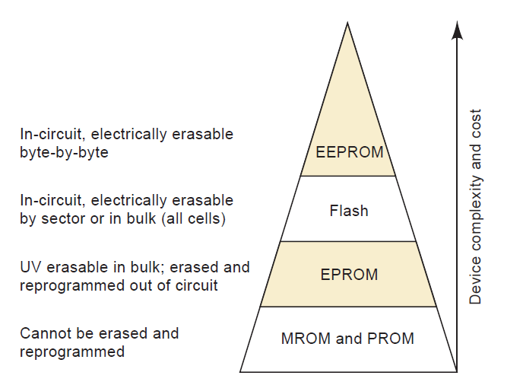
ROM Applications
Fig 5.1: Trade-offs for semiconductor nonvolatile memories show that complexity and cost increase as erase and programming flexibility increases.

Slide 31
Module-6
ROM Applications

Slide 32
ROM Applications
Embedded Microcontroller Program Memory
Data Transfer and Portability
Bootstrap Memory
Data Tables
Data Converter
Function Generator
Auxiliary Storage

Slide 33
References
Digital Systems by Tocci, Widmer, Moss
Chapter 12: Memory Devices (12.4-12.9)
Pages: 795-814

Slide 34
Thank You
Next Topics
Random Access Memory

